Slide 1
position
Taught by Yossef Ayman Zedan

Slide 2
Position values
Quick positioning classes are available, though they are not responsive.
<div class="position-static">...</div> <div class="position-relative">...</div> <div class="position-absolute">...</div> <div class="position-fixed">...</div> <div class="position-sticky">...</div>

Slide 3
Position values
Arrange elements
Arrange elements easily with the edge positioning utilities. The format is {property}-{position}.
Where property is one of:
top - for the vertical top position
start - for the horizontal left position (in LTR)
bottom - for the vertical bottom position
end - for the horizontal right position (in LTR)
Where position is one of:
0 - for 0 edge position
50 - for 50% edge position
100 - for 100% edge position

Slide 4
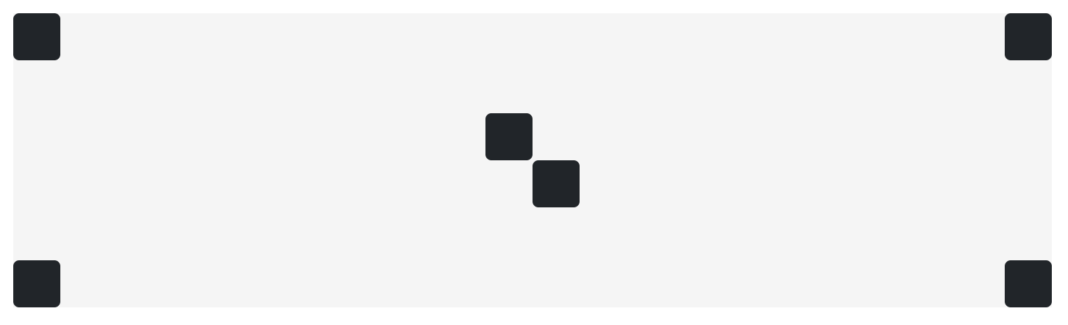
Example 1
<div class="position-relative"> <div class="position-absolute top-0 start-0"></div> <div class="position-absolute top-0 end-0"></div> <div class="position-absolute top-50 start-50"></div> <div class="position-absolute bottom-50 end-50"></div> <div class="position-absolute bottom-0 start-0"></div> <div class="position-absolute bottom-0 end-0"></div> </div>

Slide 5
Center elements
In addition, you can also center the elements with the transform utility class .translate-middle.
This class applies the transformations translateX(-50%) and translateY(-50%) to the element which, in combination with the edge positioning utilities, allows you to absolute center an element.
<div class="position-relative"><div class="position-absolute top-0 start-0 translate-middle"></div> <div class="position-absolute top-0 start-50 translate-middle"></div> <div class="position-absolute top-0 start-100 translate-middle"></div> <div class="position-absolute top-50 start-0 translate-middle"></div> <div class="position-absolute top-50 start-50 translate-middle"></div> <div class="position-absolute top-50 start-100 translate-middle"></div> <div class="position-absolute top-100 start-0 translate-middle"></div> <div class="position-absolute top-100 start-50 translate-middle"></div> <div class="position-absolute top-100 start-100 translate-middle"></div> </div>

Slide 6
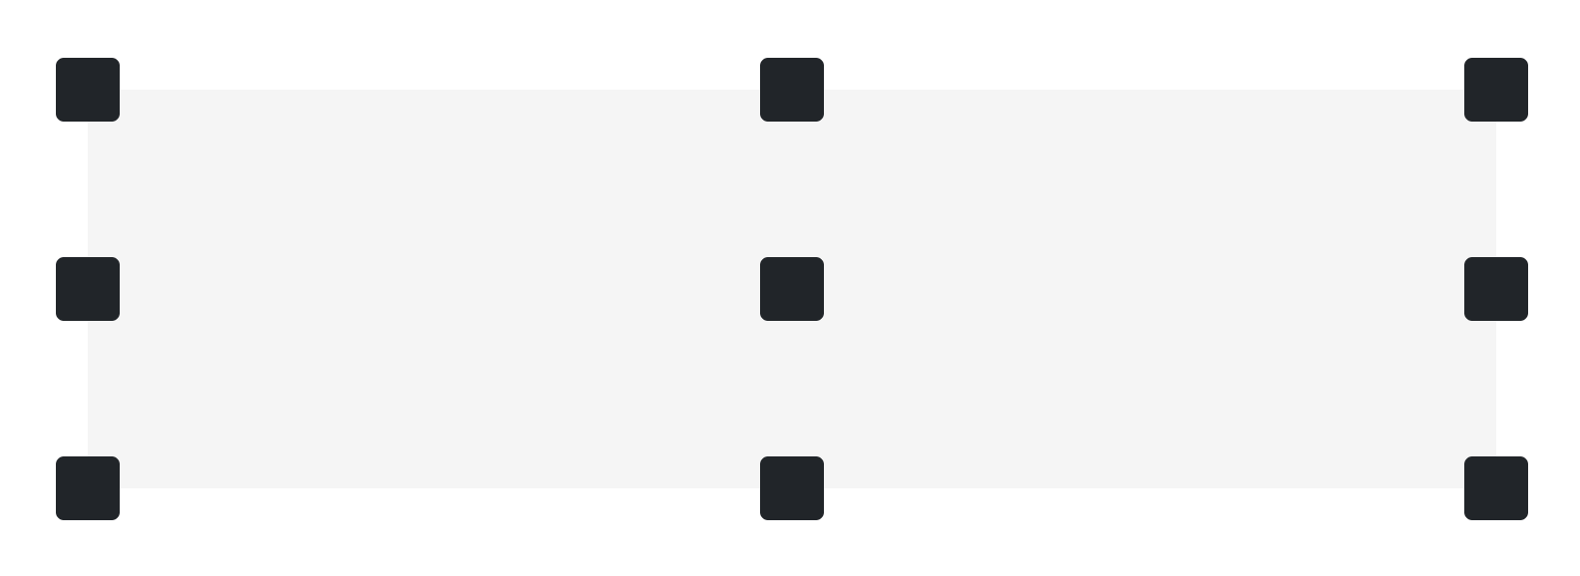
Center elements Example

Slide 7
Center elements
By adding .translate-middle-x or .translate-middle-y classes, elements can be positioned only in horizontal or vertical direction.
<div class="position-relative"> <div class="position-absolute top-0 start-0"></div> <div class="position-absolute top-0 start-50 translate-middle-x"></div> <div class="position-absolute top-0 end-0"></div> <div class="position-absolute top-50 start-0 translate-middle-y"></div> <div class="position-absolute top-50 start-50 translate-middle"></div> <div class="position-absolute top-50 end-0 translate-middle-y"></div> <div class="position-absolute bottom-0 start-0"></div> <div class="position-absolute bottom-0 start-50 translate-middle-x"></div> <div class="position-absolute bottom-0 end-0"></div> </div>

Slide 8
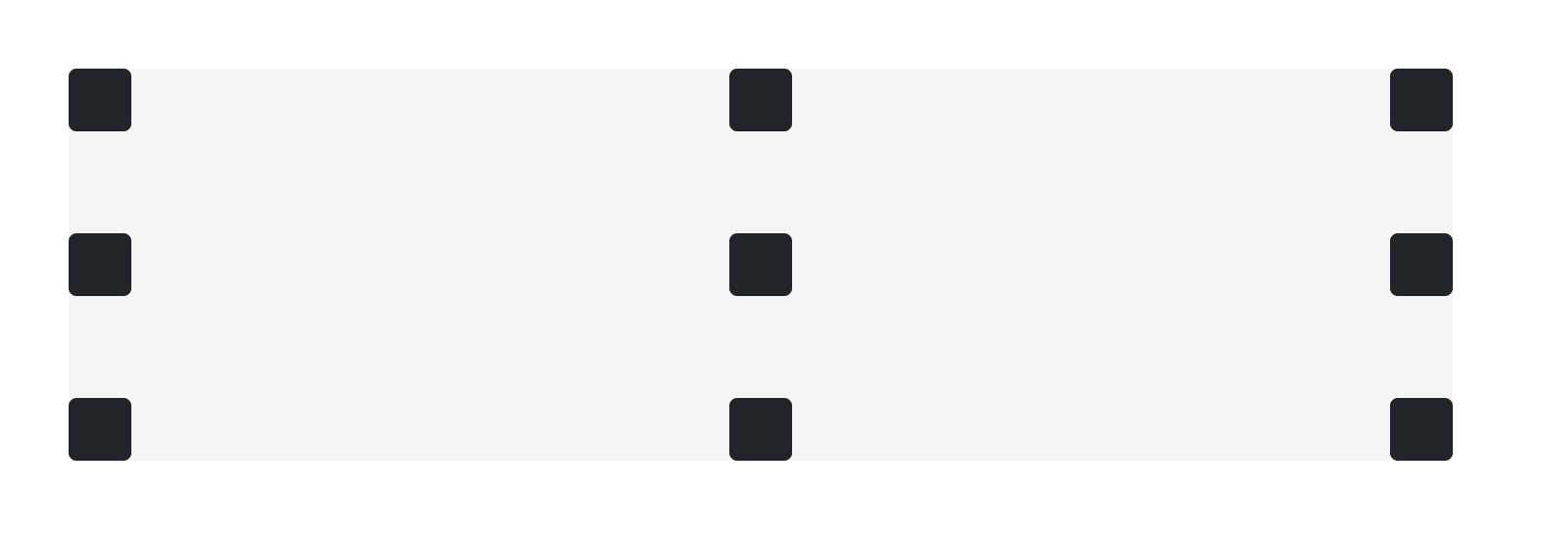
Center elements

Slide 9
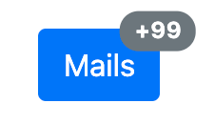
Example 2
<button type="button" class="btn btn-primary position-relative"> Mails <span class="position-absolute top-0 start-100 translate-middle badge rounded-pill bg-secondary">+99 <span class="visually-hidden">unread messages</span></span> </button>

Slide 10
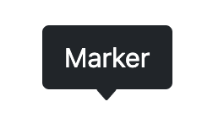
Example 3
<button type="button" class="btn btn-dark position-relative"> Marker <svg width="1em" height="1em" viewBox="0 0 16 16" class="position-absolute top-100 start-50 translate-middle mt-1 bi bi-caret-down-fill" fill="#212529" xmlns="http://www.w3.org/2000/svg"><path d="M7.247 11.14L2.451 5.658C1.885 5.013 2.345 4 3.204 4h9.592a1 1 0 0 1 .753 1.659l-4.796 5.48a1 1 0 0 1-1.506 0z"/></svg> </button>

Slide 11
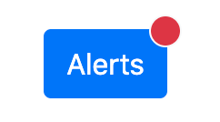
Example 4
<button type="button" class="btn btn-primary position-relative"> Alerts <span class="position-absolute top-0 start-100 translate-middle badge border border-light rounded-circle bg-danger p-2"><span class="visually-hidden">unread messages</span></span> </button>

Slide 12
Example 4
You can use these classes with existing components to create new ones. Remember that you can extend its functionality by adding entries to the $position-values variable.
<div class="position-relative m-4"> <div class="progress" style="height: 1px;"> <div class="progress-bar" role="progressbar" style="width: 50%;" aria-valuenow="50" aria-valuemin="0" aria-valuemax="100"></div> </div> <button type="button" class="position-absolute top-0 start-0 translate-middle btn btn-sm btn-primary rounded-pill" style="width: 2rem; height:2rem;">1</button> <button type="button" class="position-absolute top-0 start-50 translate-middle btn btn-sm btn-primary rounded-pill" style="width: 2rem; height:2rem;">2</button> <button type="button" class="position-absolute top-0 start-100 translate-middle btn btn-sm btn-secondary rounded-pill" style="width: 2rem; height:2rem;">3</button> </div>

Slide 13
Example 4

